Slide 1


Building an Ontology of Boardgame Mechanics based on the BoardGameGeek Database and the MDA Framework
Joshua Kritz¹
Eduardo Mangeli^{1,2}
Geraldo Xexéo^{1,2}
¹Departamento de Ciência da Computação/ Instituto de Matemática
²Programa de Engenharia de Sistemas e Computação/COPPE

Slide 2
LUDES
LUDES is a laboratory created to research Games and Simulations with the tools of Engineering, aiming to understand:
What is a game
Why people play games
What is quality for games
How to develop games
What are the impacts of games

Slide 3
This work
Built a domain sub-ontology from BGG [1] database
The ontology is not exhaustive
Creating a tool for designers and scholars

Slide 4
BoardGameGeek
One of the biggest and most used Boardgame forum
92018 games, 2536 families, 84 categories, 51 mechanics [1]
User contribution
The BGG 51 mechanics list

Slide 5
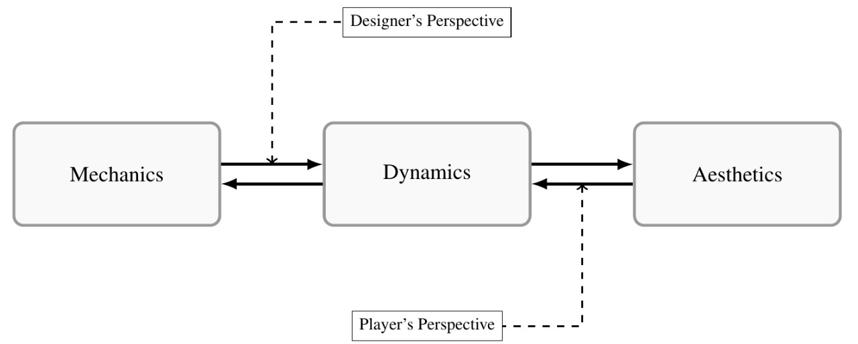
The MDA framework
Mechanics, Dynamics & Aesthetics [9]
Games from the player perspective

Slide 6
Methodology
Based on MENELAS [2,11]
Built upon common-sense knowledge
Simplicity and adequacy to the domain

Slide 7
Scope
Only concepts identifiable in the BGG mechanics list should appear as leaves of the ontology
For each of the 51 mechanics there should be a decision if it is a mechanic or not accordingly to MDA
Higher level concepts should be based on the MDA Framework, references or on the BGG mechanics list
Compound mechanics should be broken in their constituents

Slide 8
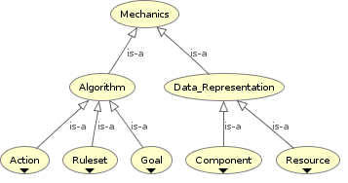
The Ontology

Slide 9
The Ontology
Part-of Relations
BGG mechanics left out:
Hex & Counter (Grid Movement & Token)
Deck Building (Pool Building & Card)
Crayon Rail System (Network Building & Paper and pencil)
Not Mechanics:
Hand Management
Simulation

Slide 10
Conclusion
The Ontology must be improved
Some questions answered…
Future steps...
To a brighter future

Slide 11
References
[1] BoardGameGeek. Boardgamegeek|game mechanics. https://boardgamegeek.com/browse/boardgamemechanic. (Accessed on 07/28/2017).
[2] J. Bouaud, B. Bachimont, J. Charlet, and P. Zweigenbaum. Methodological principles for structuring an “ontology”. In Proceedings of the IJCAI’95 Workshop on “Basic Ontological Issues in Knowledge Sharing, pages 19–25, 1995.
[3] F. Calado, L. Vasconcelos, A. M. Neves, F. Narto, and M. Guimarãesa. Modelo para avaliação do grau de novidade de jogos digitais. In Proceedings of SBGames 2015, 2015.
[4] G. Costikyan. I have no words and i must design. Interactive Fantasy: The Journal of Role-Playing and Story-Making Systems, 2, 1994.
[5] G. Costikyan. I have no words and i must design. In K. Salen and E. Zimmerman, editors, The Game Design Reader: A Rules of Play Anthology, pages 192–211. The MIT Press, Oxford, 2005.
[6] gameontology. Main page—gameontology,, 2015. [Online; accessed 6-August-2017].
[7] G. Guizzardi. Ontological foundations for structural conceptual models.
PhD thesis, Telematica Instituut / CTIT, 10 2005.

Slide 12
References
[8] S. Howard. Three hundred mechanics, 2014. [Online; accessed 6- August-2017].
[9] R. Hunicke, M. LeBlanc, and R. Zubek. Mda: A formal approach to game design and game research. In In Proceedings of the Challenges in Games AI Workshop, Nineteenth National Conference of Artificial Intelligence, pages 1–5, 2004.
[10] IMDb. Imdb. http://www.imdb.com. [Online; accessed on 05- August-2017].
[11] D. Jones, T. Bench-Capon, and P. Visser. Methodologies for ontology development. In Proc. IT&KNOWS Conference of the 15th IFIPWorld Computer Congress. na, 1998.
[12] A. Järvinen. Games without Frontiers: Theories and Methods for Game Studies and Design. Tampere University Press, 2008.
[13] F. Malcher, A. M. M. Neves, and L. Falcão. Aplicação do game ontology project no processo de análise de similares para design de jogos. In Annals of the VIII Brazilian Symposium on Games and Digital Entertainment, 2009.
[14] M. A. Musen. The protégé project: a look back and a look forward. AI matters, 1(4):4–12, 2015.
[15] N. F. Noy, D. L. McGuinness, et al. Ontology development 101: A guide to creating your first ontology, 2001.
[16] J. Rohrer. New mechanic or category? secret player roles.

Slide 13
References
[17] M. Roman, I. Sandu, and S. C. Buraga. Owl-based modeling of rpg games. Studia Universitatis Babes-Bolyai, 56(3):83, 2011.
[18] K. Salen and E. Zimmerman. Rules of Play: Game Design Fundamentals. The MIT Press, 2003.
[19] K. Salen and E. Zimmerman. The Game Design Reader: A Rules of Play Anthology. The MIT Press, 2005.
[20] the Mana World. the mana world. [Online; accessed 6-August-2017].
[21] A. Tucker. Looking for a good list of role selection games.
[22] B. O. ‹uric and M. Konecki. Specific owl-based rpg ontology. In Central European Conference on Information and Intelligent Systems, page 185. Faculty of Organization and Informatics Varazdin, 2015.
[23] J. P. Zagal and A. Bruckman. The game ontology project: Supporting learning while contributing authentically to game studies. In Proceedings of the 8th International Conference on International Conference for the Learning Sciences - Volume 2, ICLS’08, pages 499–506. International Society of the Learning Sciences, 2008.

Slide 14
LUDES.COS.UFRJ.BR
Joshua Kritz – joshuak@cos.ufrj.br
Eduardo Mangeli – mageli@cos.ufrj.br
Geraldo Xexéo – xexeo@cos.ufrj.br
For papers, games and other work, please consult our website

